Slide 1
Flow Control Instructions
Course Code: CSC 2106
Course Title: Computer Organization and Architecture
Dept. of Computer Science
Faculty of Science and Technology
Lecturer No: | 6.2 | Week No: | 8 | Semester: | Fall 21_22
Lecturer: | Syeda Anika Tasnim anika.tasnim@aiub.edu

Slide 2
Lecture Outline
Decision making and repeating statement
Jump and loop instructions
Algorithm conversion to assembly language
High-Level Language Structures

Slide 3
Branches with Compound Conditions
Sometimes the branching condition in an IF or CASE takes the form
condition_1' AND condition_2’
or
condition_1 OR condition_2
Where condition 1 and condition:2 are either true or false. We will refer to the
First of these as an AND condition and to the second as an OR condition.

Slide 4
Example : AND
An AND condition is true if and only if Condition_1 and Condition_2 are both true. Likewise, if either condition is false, then the whole thing is false.
Read a character, and if it's an uppercase letter, display it.
Read a character (into AL)
IF ('A'<= character) and (character <= 'Z')
THEN
display character
END IF

Slide 5
Converting to Assembly
;read a character
MOV AH,1
INT 21H
if ('A' <= char> and (chai: <= 'Z')
CMP AL, ‘A ;char >’A’
JNGE END_lF ;no exit
CMP AL, 'Z'
JNGE END_lF ;no exit
MOV DL, AL.
MOV AH, 2
INT 21H
END_IF:

Slide 6
OR Conditions
Condition_1 OR condition_2 is true if at least one of the conditions is true; it is only false when both conditions are false.
Read a character. If it's "y" or "Y", display it; otherwise, terminate the program.
Read a character (into AL)
IF (character = ‘y‘) OR (character = 'Y‘)
THEN
display it
ELSE
terminate the program
END IF

Slide 7
Assembly Conversion
MOV AH,1 INT 21H CMP AL,’y’ ;AL==‘y’ JE THEN CMP AL, 'Y';char ~ 'Y'? JE THEN ;yes, go to display it JMP ELSE_ ;no - Terminate | THEN: MOV AH,2 ;prepare to display MOV CL,AL ;get char INT 21H ;display it JMP END IF ;and exit – ELSE_: MOV AH, 4CH INT 21H ;DOS exit END_IF:

Slide 8
Looping Structure
A loop Is a sequence of instructions that is repeated.
The number of times to repeat may be known in advance, or
It may depend on conditions
1. FOR LOOP
2. WHILE LOOP
3. REPEAT LOOP

Slide 9
FOR LOOP
FOR LOOP is a loop structure in which the loop statements are repeated a known number of times (a count-controlled loop). In pseudo code,
FOR loop_count times DO
Statements
END_FOR
The LOOP instruction can be used to implement a FOR loop. i.e.
LOOP destination_label
The counter for the loop is the register CX which is initialized to loop_count.
Execution of the LOOP Instruction causes CX to be decremented automatically,

Slide 10
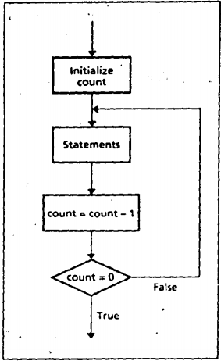
FOR LOOP
The control is transferred to destination_label until CX becomes 0.
A FOR LOOP can be implemented using the LOOP instruction:
TOP:
;initialize CX to loop_count
;body of the loop
LOOP TOP

Slide 11
Example:
Write a count-controlled loop to display a row of 80 stars:
FOR 80 times DO
display ‘*’
END_FOR
MOV CX,80
MOV AH,2
MOV DL, '*‘
TOP:
INT 21H
LOOP TOP

Slide 12
JCXZ and The LOOP
FOR LOOP executes at least once.
if CX contains 0 when the loop is entered, the LOOP instruction causes CX to be decremented to FFFFh
The loop is then executed FFFFh=65535 times more!
To Prevent this, the instruction JCXZ (jump if CX is zero) may be used before the loop. Its syntax
JCXZ destination_label

Slide 13
Use of JCXZ
If CX contains 0, control transferred to the destination label. So a loop implemented as follows is bypassed if CX is 0:
JCXZ SKIP
TOP:
;body of the loop
LOOP TOP
SKIP:

Slide 14
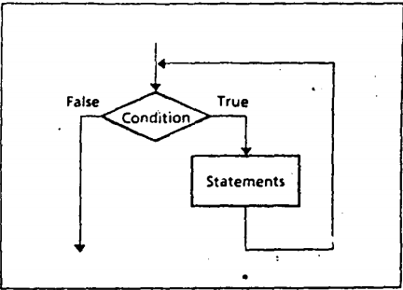
WHILE LOOP
This WHILE LOOP depends on a condition.
WHILE condition DO
statements
END_WHILE

Slide 15
WHILE LOOP
The condition is checked at the top of the loop.
If true, the statements are executed;
If false, the program goes on to whatever follows.
It is possible the condition will be false initially, in which case the loop body ls not executed at all.
The loop executes as long as the condition is true

Slide 16
Example: WHILE LOOP
MOV DX,0 ; char count
MOV AH,1
INT 21H
WHILE_:
CMP AL,0DH ; CR ?
JE END_WHILE ;yes, exit INC DX ; not CR so inc
INT 21H ; read next char
JMP WHILE_ ; loop again
END_WHILE:
Write code to count the number of characters in an input line.
Initialize count to 0
Read a character
WHILE character <> carriage_return DO
count =count + 1
read a character
END_WHILE

Slide 17
WHILE LOOP Insights
A WHILE loop checks the terminating condition at the top of the loop,
So, you must make sure that any variables involved in the condition are initialized before the loop is entered.
So you read a character before entering the loop, and read another one at the bottom.
The label WHILE_: .is used because WHILE is a reserved word

Slide 18
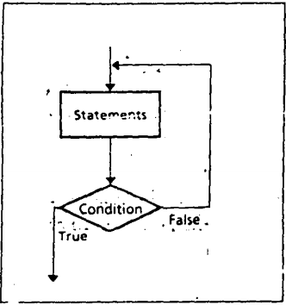
REPEAT LOOP
REPEAT statements
UNTIL condition
In a REPEAT…UNTIL loop, the statements are executed, and then the condition is checked.
If true, the loop terminates;
If false, control branches to the top of the loop.

Slide 19
Example: REPEAT LOOP
Write code to read characters until a blank is read.
MOV AH,1
REPEAT:
INT 21H
CMP AL,' '
JNE REPEAT
REPEAT
read a character
UNTIL character is a BLANK

Slide 20
Difference between WHILE and REPEAT
Use of a WHILE loop or a REPEAT loop Is a matter of personal preference.
The advantage of a WHILE is that the loop can be bypassed if the terminating, condition is initially false.
Whereas the statements in a REPEAT must be done at least once.
However, the code for a REPEAT loop Is likely to be a little shorter because there is only a conditional jump at the end,
But a WHILE loop has two jumps: a conditional jump at the top and a JMP at the bottom.

Slide 21
Difference between WHILE and REPEAT
Use of a WHILE loop or a REPEAT loop Is a matter of personal preference.
The advantage of a WHILE is that the loop can be bypassed if the terminating, condition is initially false.
Whereas the statements in a REPEAT must be done at least once.
However, the code for a REPEAT loop Is likely to be a little shorter because there is only a conditional jump at the end,
But a WHILE loop has two jumps: a conditional jump at the top and a JMP at the bottom.

Slide 22
References
Assembly Language Programming and Organization of the IBM PC, Ytha Yu and Charles Marut, McGraw Hill, 1992. (ISBN: 0-07-072692-2).
https://www.slideshare.net/prodipghoshjoy/flow-control-instructions-60602372

Slide 23
Books
Assembly Language Programming and Organization of the IBM PC, Ytha Yu and Charles Marut, McGraw Hill, 1992. (ISBN: 0-07-072692-2).
Essentials of Computer Organization and Architecture, (Third Edition), Linda Null and Julia Lobur
W. Stallings, “Computer Organization and Architecture: Designing for performance”, 67h Edition, Prentice Hall of India, 2003, ISBN 81 – 203 – 2962 – 7
Computer Organization and Architecture by John P. Haynes.

